Slide 1
Application Lifecycle Management with Visual Studio 2010
November 6, 2009
Brian Keller
Brian.Keller@Microsoft.com
http://blogs.msdn.com/briankel
Sr. Technical Evangelist
Microsoft Corporation

Slide 2

Visual Studio 2010 Pillars of Application Lifecycle Management
Business Alignment
Effectively plan and deliver the right software that meets your business’ need with clear visibility along the way
Testing & Application Quality
Build applications that really work - starting with great tools to drive quality early planning and development and extending through the test team with powerful new testing tools like functional testing and test case management
Unspoken 3rd “pillar”
Deliver what customers ask for

Slide 3
Business Alignment

Slide 4

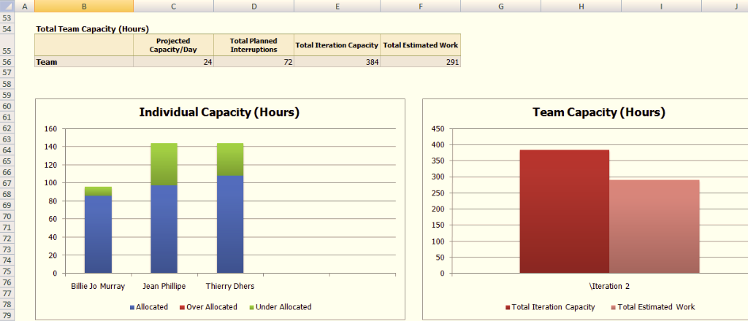

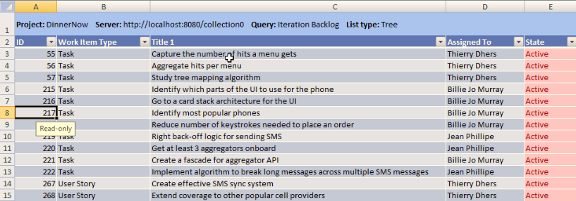
Top-to-bottom Traceability
Top-to-Bottom Traceability
Requirements Traceability
Parent/Child Relationships
Rollup and Drilldown
Agile Planning
Built-in product backlog mgmt
Built-in iteration planning
Easily customizable
Great Project Integration
Full dependency linking
Full round-tripping w/ TFS
Notes:
TODO: Talking points.

Slide 5

Agenda
Scrum with TFS 2010 using MSF for Agile 5.0
Planning the Project
How do you plan the project?
Project planning in TFS 2010
Planning a Sprint
What is sprint planning?
Sprint planning in TFS 2010
Running a Sprint
How do you run a sprint?
Running a sprint in TFS 2010

Slide 6
How do you Plan the Project?
Product Backlog
Evolving backlog of user stories (requirements)
Describes what your users need and value
Owned by the Product Owner
Prioritized by business value
Each story is written from the user’s perspective

Slide 7
Planning the Project
Product Backlog
“As a new customer I want to register online so I can use the services offered”
User Stories
5
8
Stories are listed on the backlog in priority order
5
The team estimates each story using story points
Priority
3
New stories are added to the product backlog
8
1

Slide 8
Planning the Project
Product Backlog
Stories are planned for completion in upcoming sprints
Sprint 3
User Stories
3
3
Sprint 4
3
The product owner re-prioritizes the backlog
Priority
4
4
4
Notes:
Swamp 2 + 5…

Slide 9
Managing the Product Backlog

Slide 10
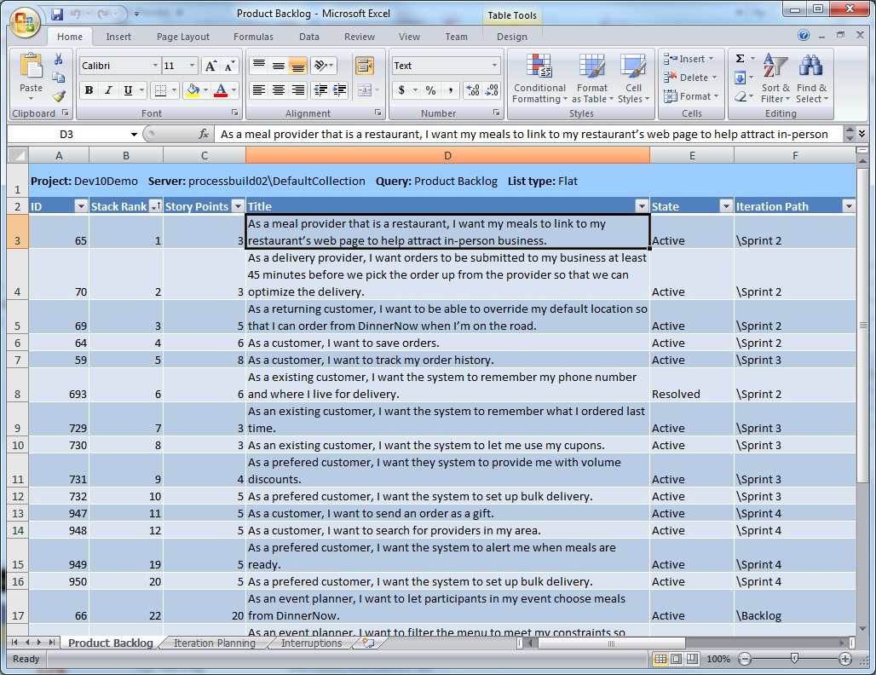
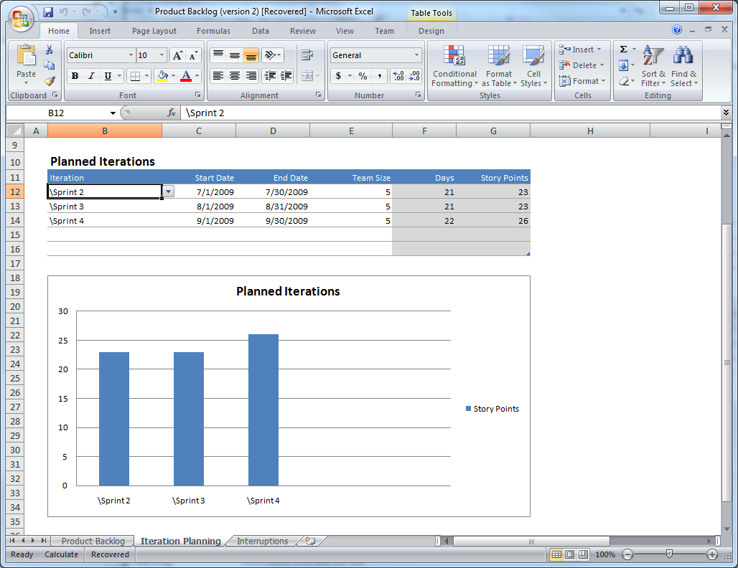
Product Backlog in TFS 2010
Product Backlog query
Creating new user stories
Prioritizing
Estimating story points
Add user stories to upcoming sprints

Slide 11
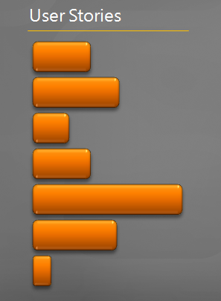
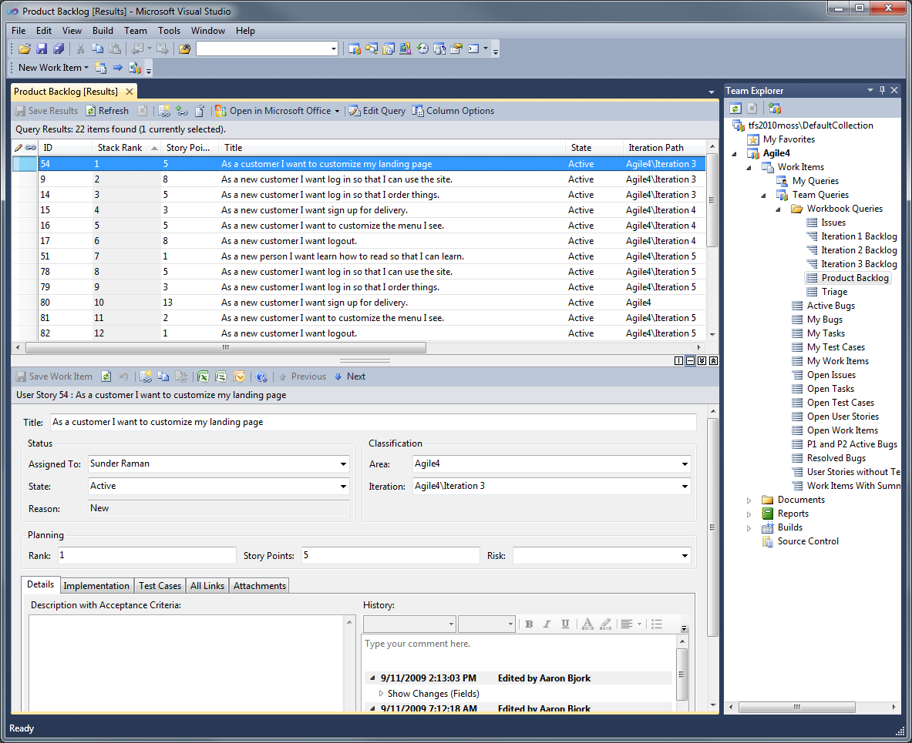
Product Backlog
Product backlog query in Team Explorer

Slide 12
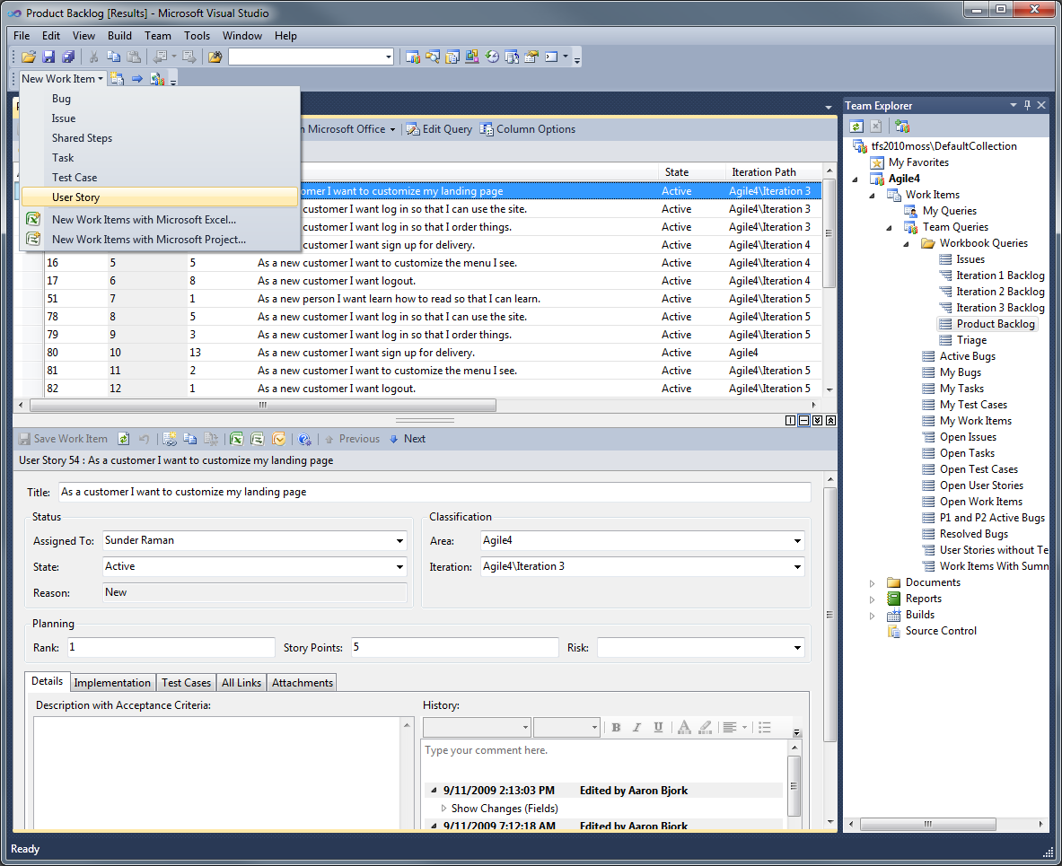
Product Backlog
New stories created by the Product Owner

Slide 13
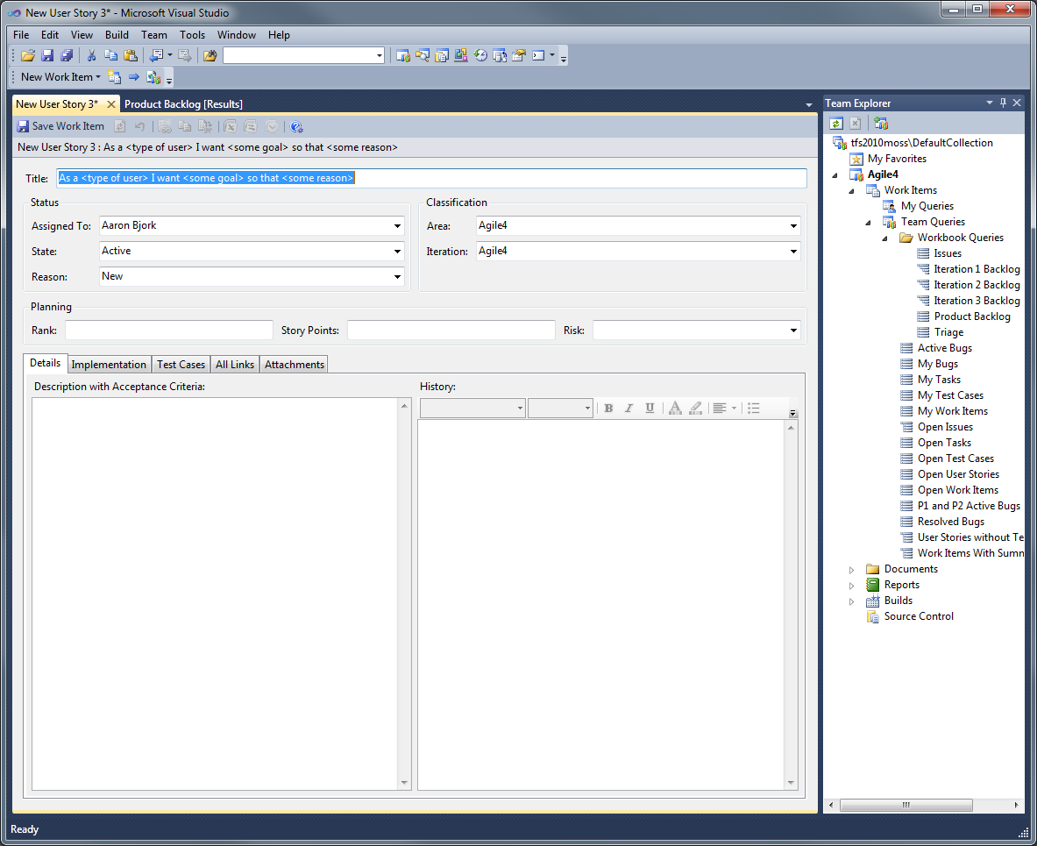
Product Backlog
The new story provides a guide to ensure the story is written from the customer’s perspective

Slide 14
Product Backlog
Each story is ranked by priority and assigned a story point value

Slide 15
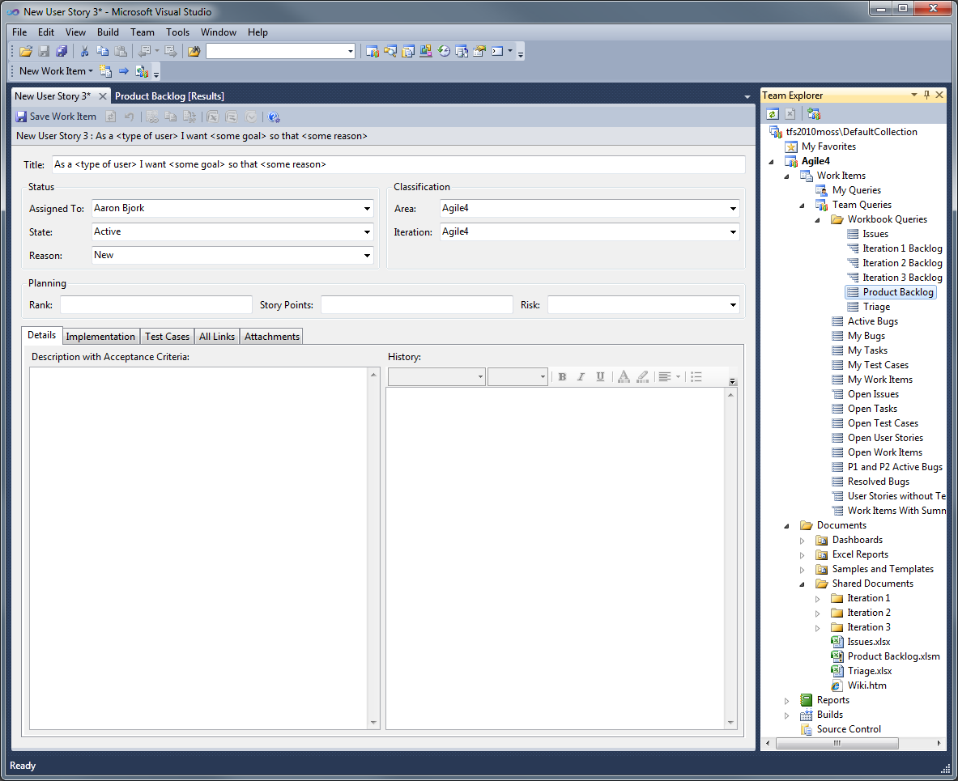
Product Backlog
Product Backlog workbook for planning future sprints

Slide 16
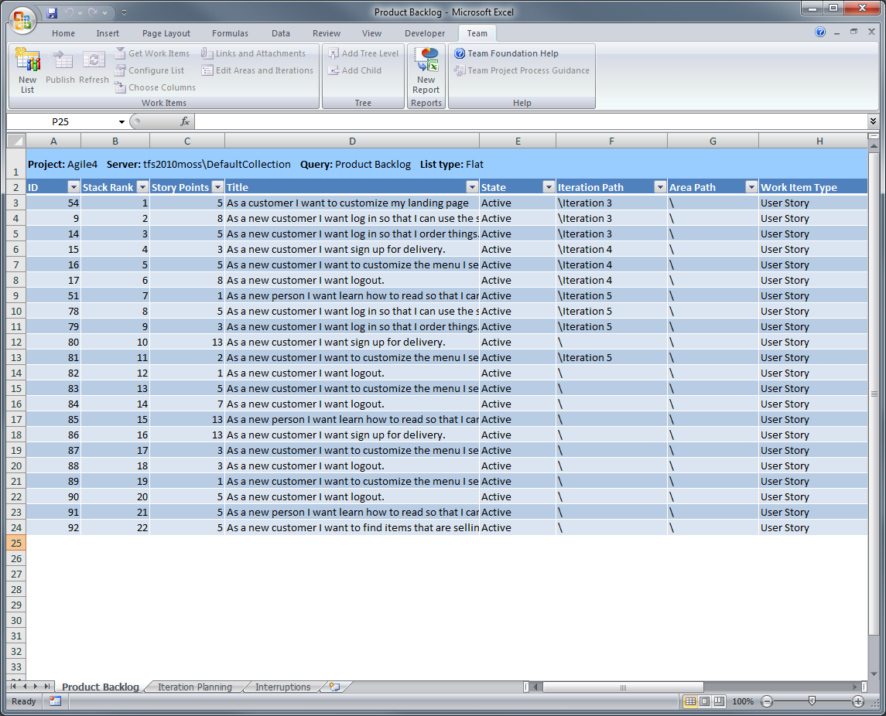
Product Backlog Workbook
Stories that are too large are left on the backlog
Each story is placed in an upcoming sprint

Slide 17
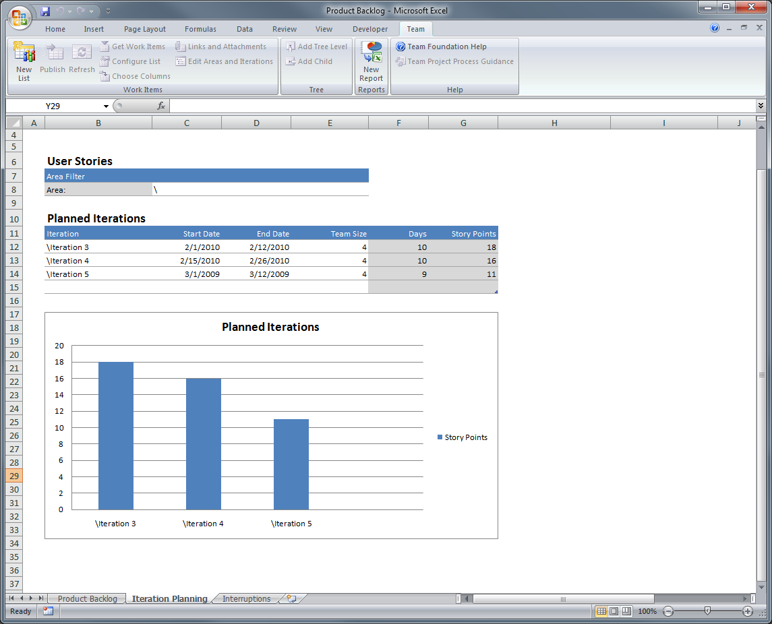
Product Backlog Workbook
The product owner can visualize the number of story points planned for upcoming sprints
… with start/end dates and the size of the team
Each sprint is added to Iteration Planning worksheet…

Slide 18

Agenda
Scrum with TFS 2010 using MSF for Agile 5.0
Planning the Project
How do you plan the project?
Project planning in TFS 2010
Planning a Sprint
What is sprint planning?
Sprint planning in TFS 2010
Running a Sprint
How do you run a sprint?
Running a sprint in TFS 2010

Slide 19
What is Sprint Planning?
The product owner and the team add user stories to the sprint
Each story is decomposed into tasks
The team makes a commitment to each user story
Notes:
Mitch: Estimation is a tool used by the team that allows it to commit to its work

Slide 20
Planning a Sprint
Product Backlog
Iteration Backlog
User Stories
User Stories
Tasks (hours)
Based on estimates the team commits to each story
Commit!
1
1
1
During the sprint planning meeting, the product owner and the team add User Stories to the sprint
The team breaks down each story into tasks
Commit!
The team thinks this story is more work than they can commit to…
Can’t Commit!
Notes:
Add animation and a “can’t commit”…
Move a smaller up…

Slide 21
Planning a Sprint
Product Backlog
Iteration Backlog
User Stories
User Stories
Tasks (hours)
Commit!
1
1
1
The larger story is removed from the sprint and the team considers a smaller story on the backlog
Commit!
?
1
The sprint is now planned and the team is ready to get started!
The team can commit to this smaller story
Commit!
Notes:
Add animation and a “can’t commit”…
Move a smaller up…

Slide 22
Demo: Sprint Planning

Slide 23
Agenda
Scrum with TFS 2010 using MSF for Agile 5.0
Planning the Project
How do you plan the project?
Project planning in TFS 2010
Planning a Sprint
What is sprint planning?
Sprint planning in TFS 2010
Running a Sprint
How do you run a sprint?
Running a sprint in TFS 2010

Slide 24
Running a Sprint

Slide 25
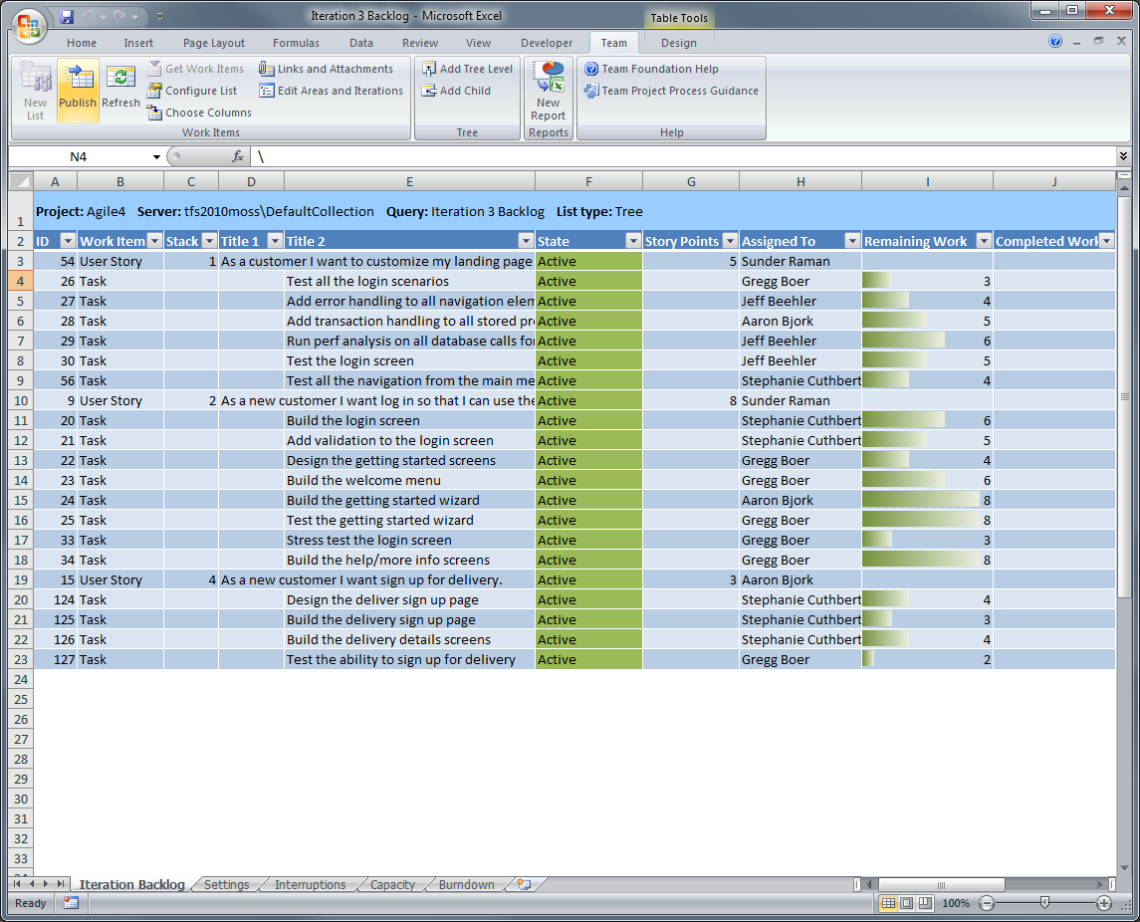
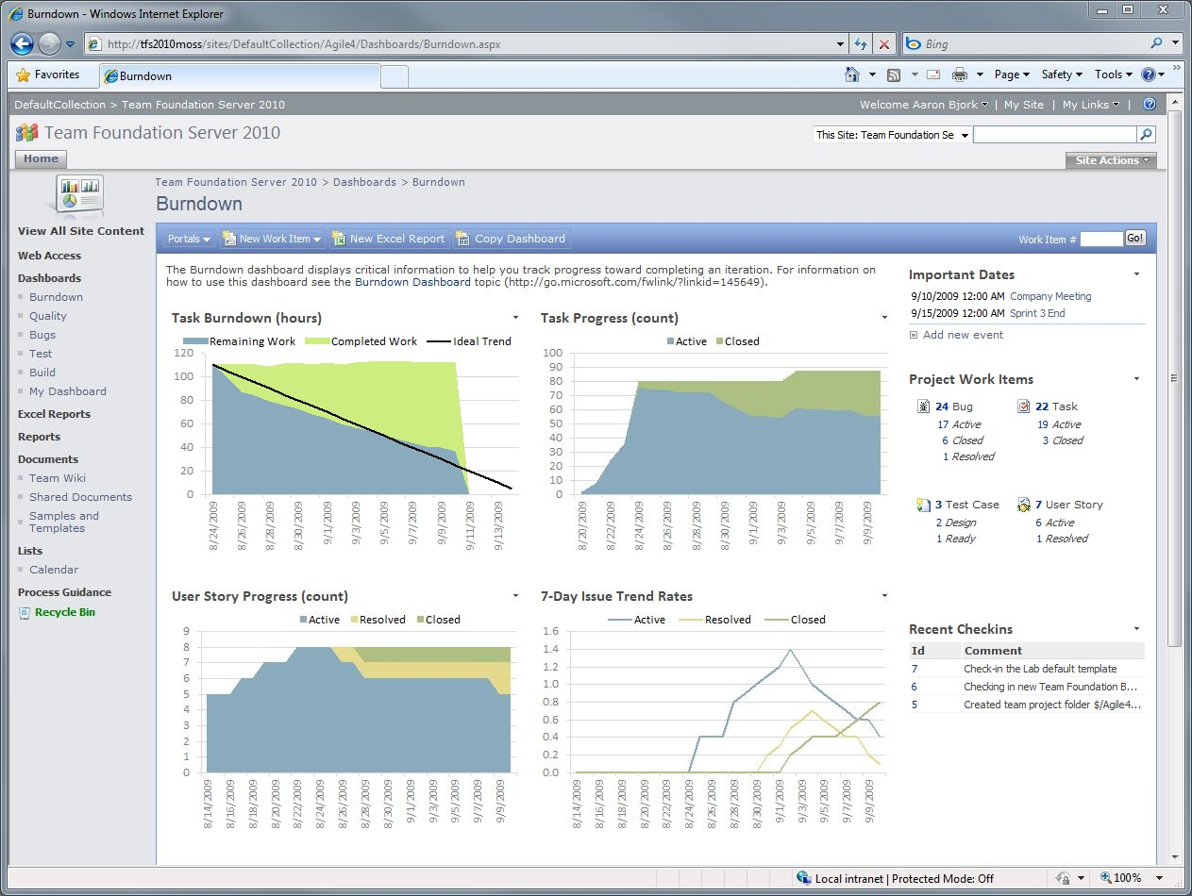
Running a Sprint
Record completed work
Track progress with reports and dashboards
Retrospectives

Slide 26
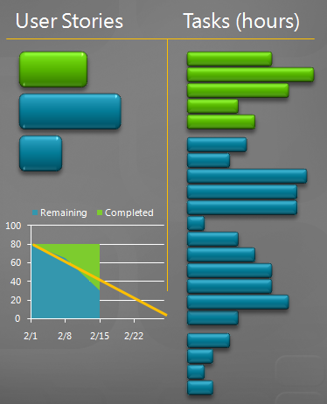
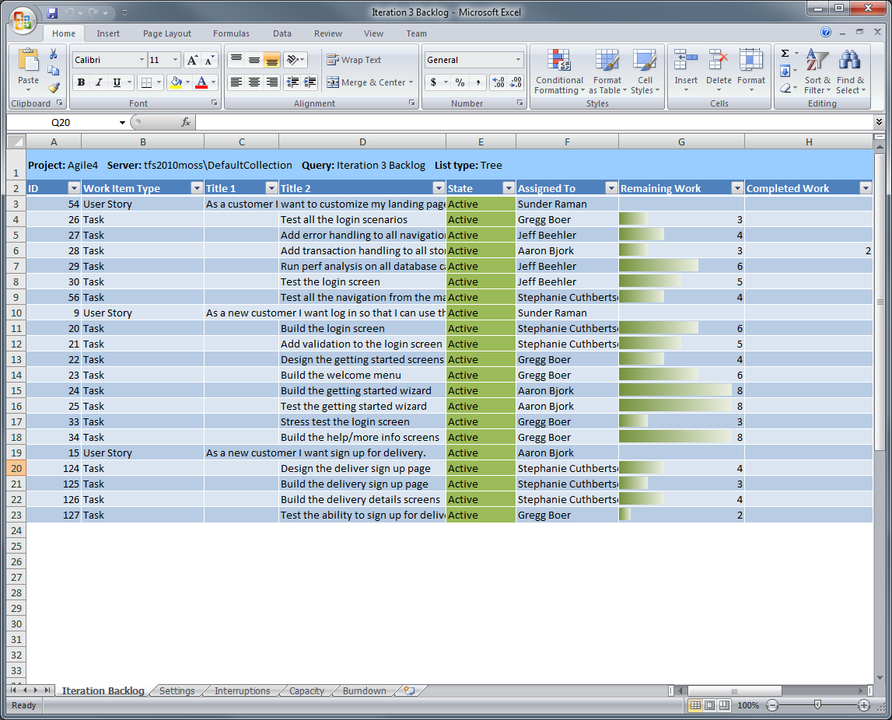
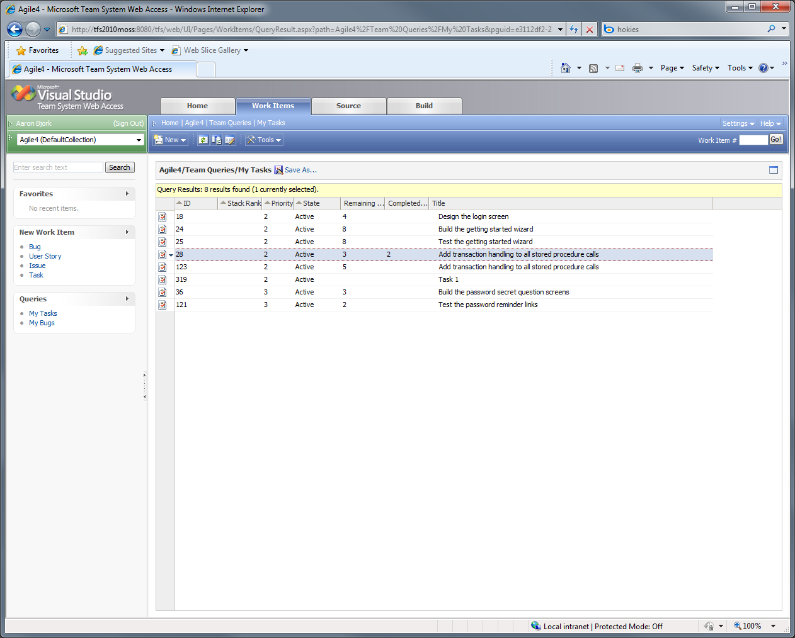
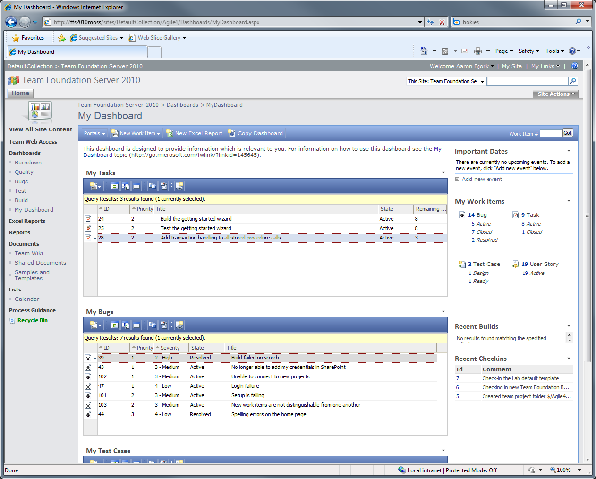
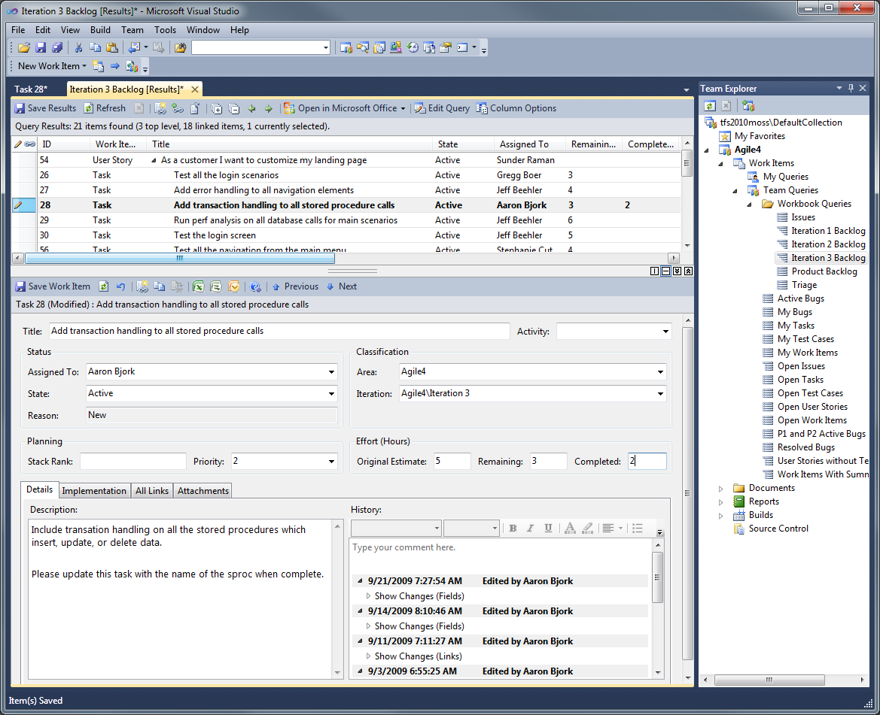
Updating Tasks
Multiple interfaces for updating work items

Slide 27
Updating Tasks
Team Explorer

Slide 28
Updating Tasks
Iteration Backlog workbook

Slide 29
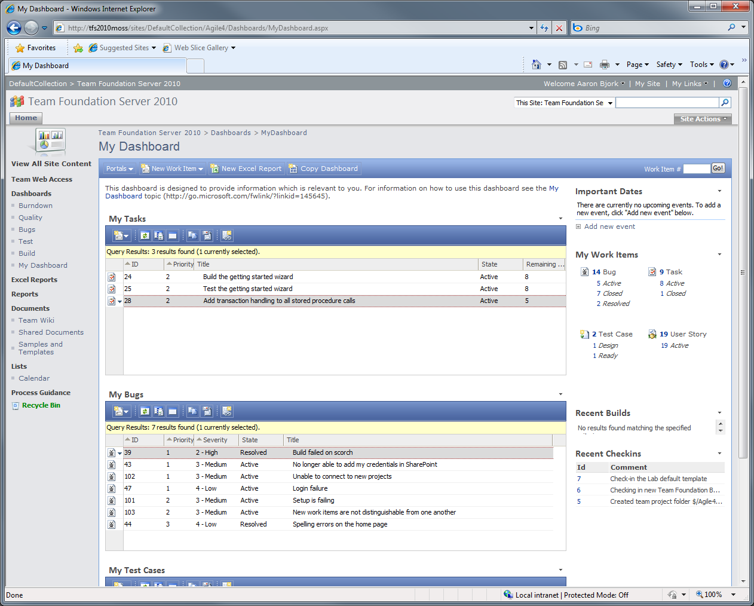
Updating Tasks
Team Project portal

Slide 30
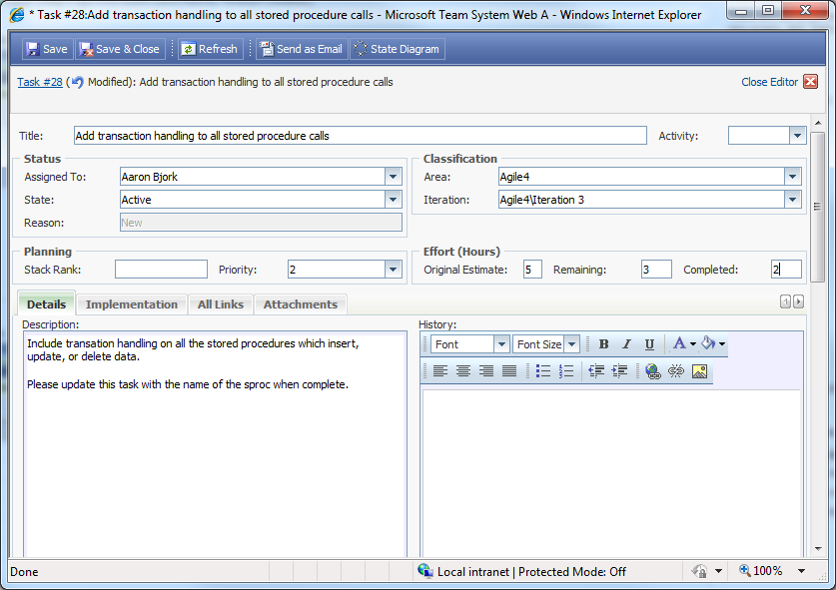
Updating Tasks

Slide 31
Updating Tasks

Slide 32
Updating Tasks
Team System Web Access

Slide 33
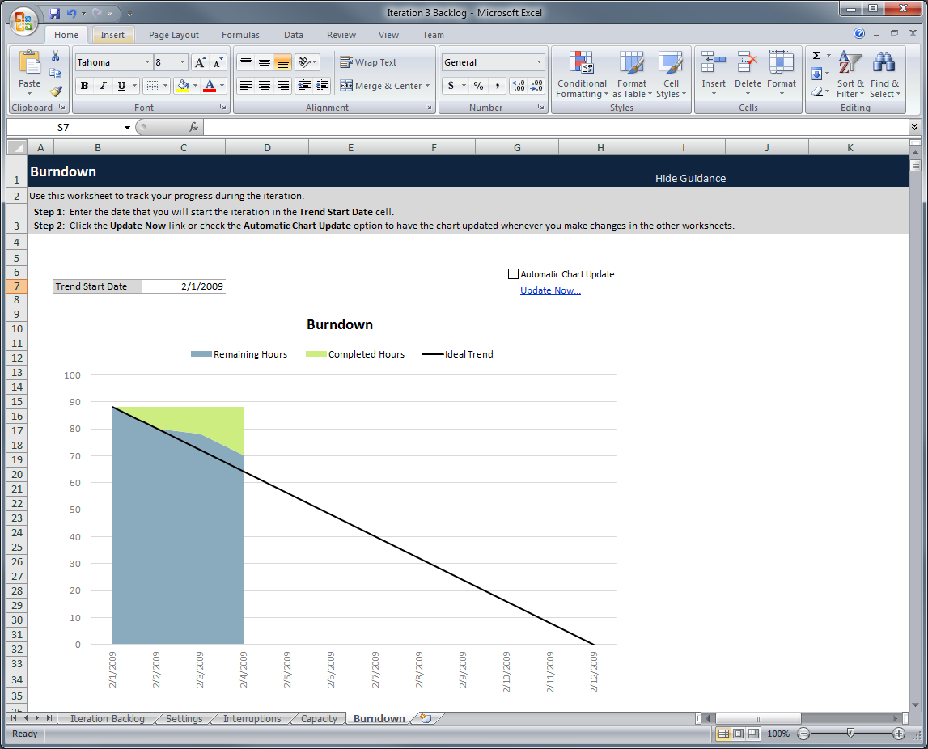
Tracking Progress
Burndown chart tracks remaining and completed work

Slide 34
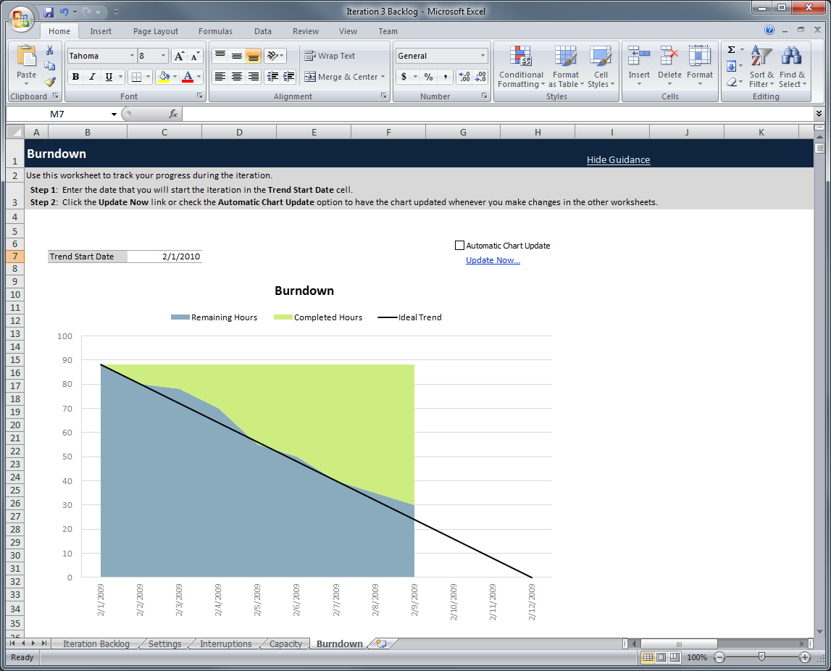
Tracking Progress

Slide 35
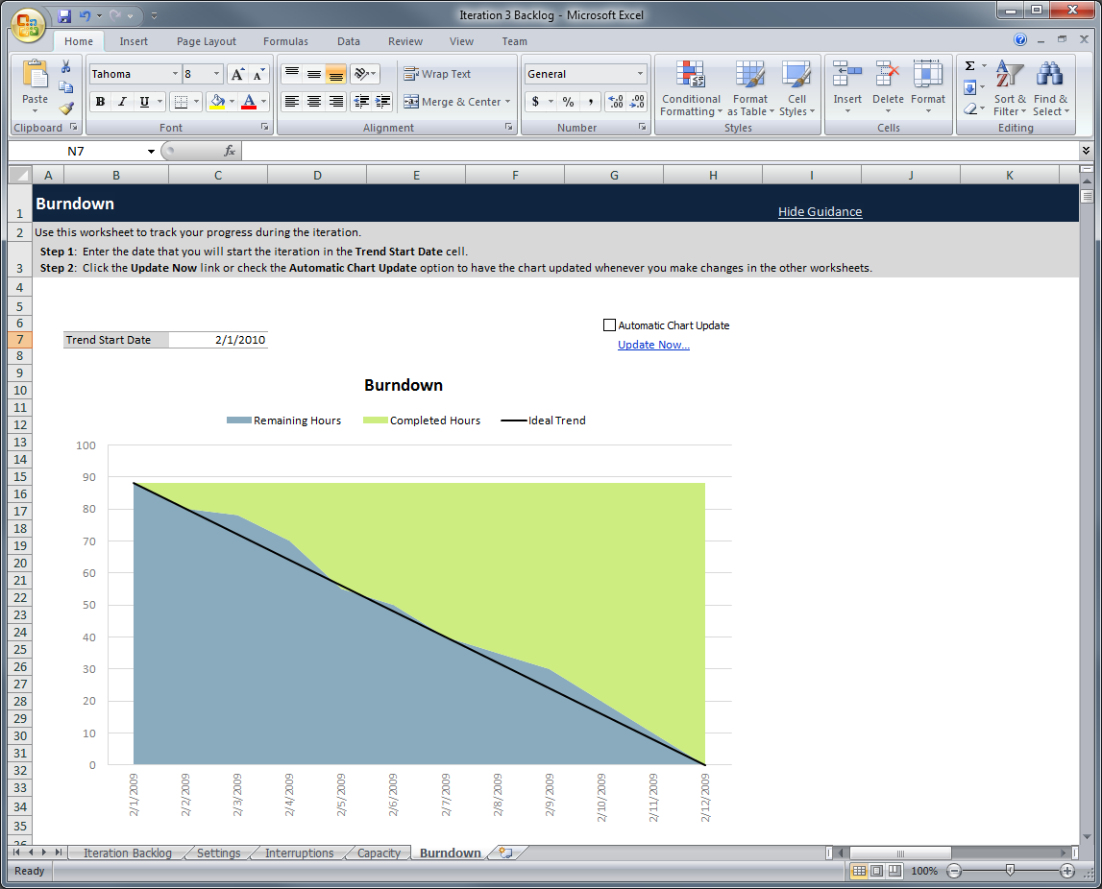
Tracking Progress

Slide 36
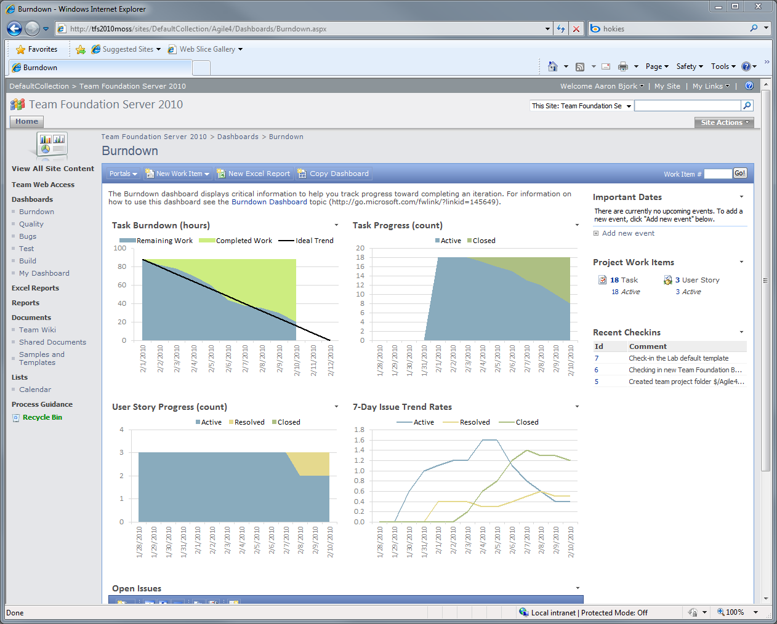
Tracking Progress
Detailed sprint progress is tracked on the project portal
The burndown shows the team on track…
And almost half of the tasks remain open
But the team hasn’t closed any of the three stories…

Slide 37
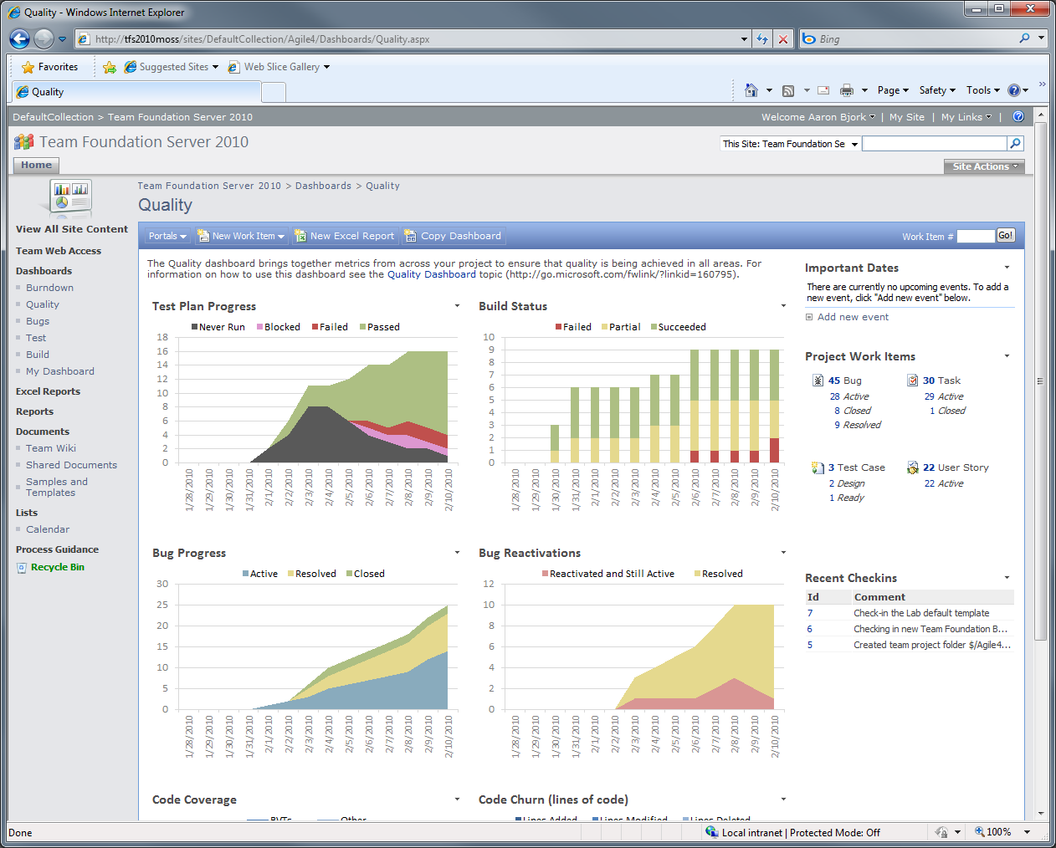
Tracking Progress
The portal brings data together so it can be analyzed to ensure success on a sprint
Test are passing…
But bugs are climbing steadily

Slide 38
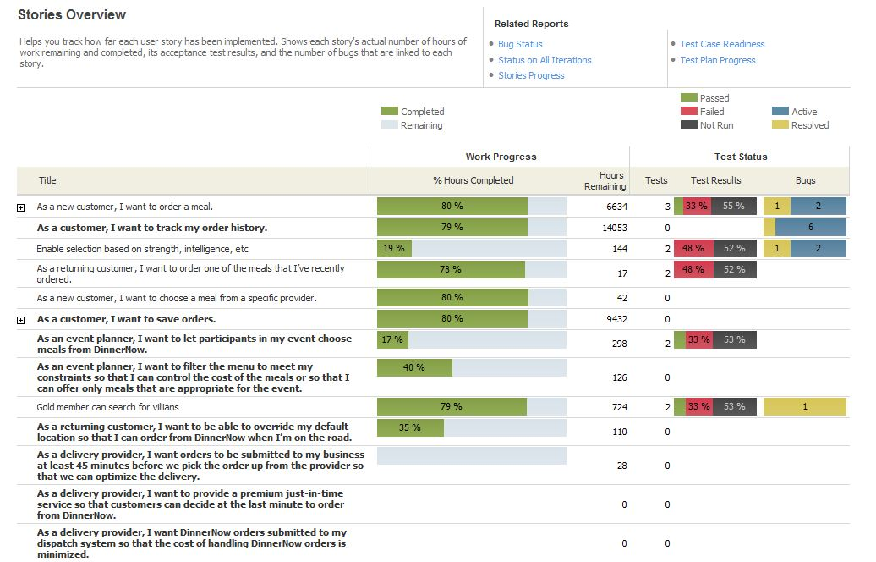
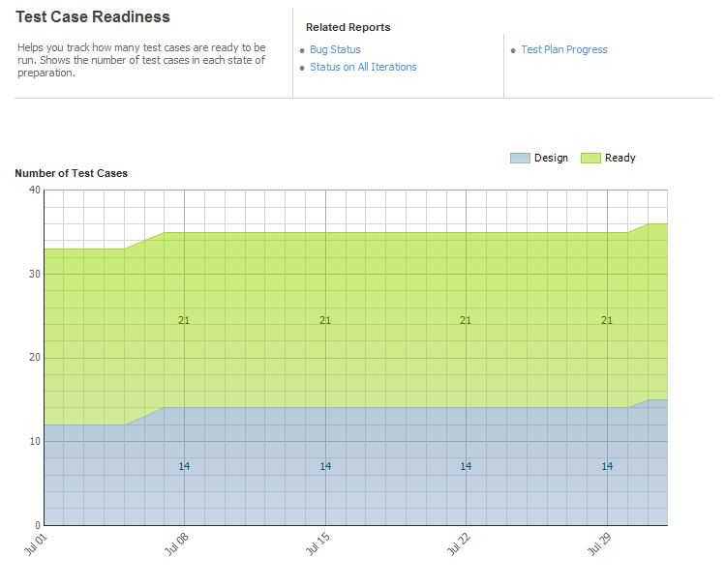
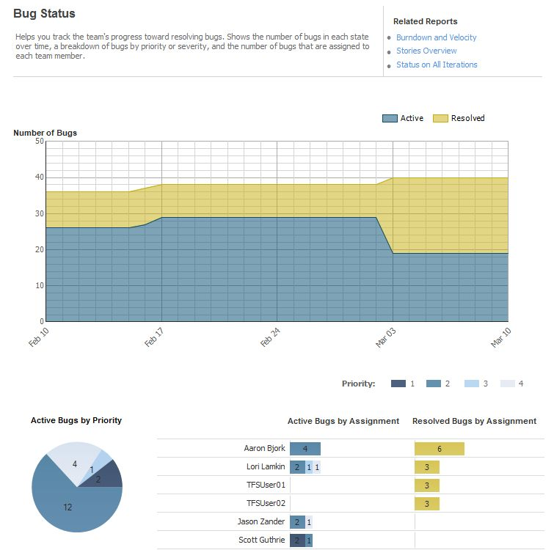
Tracking Progress
Rich set of reports track progress

Slide 39
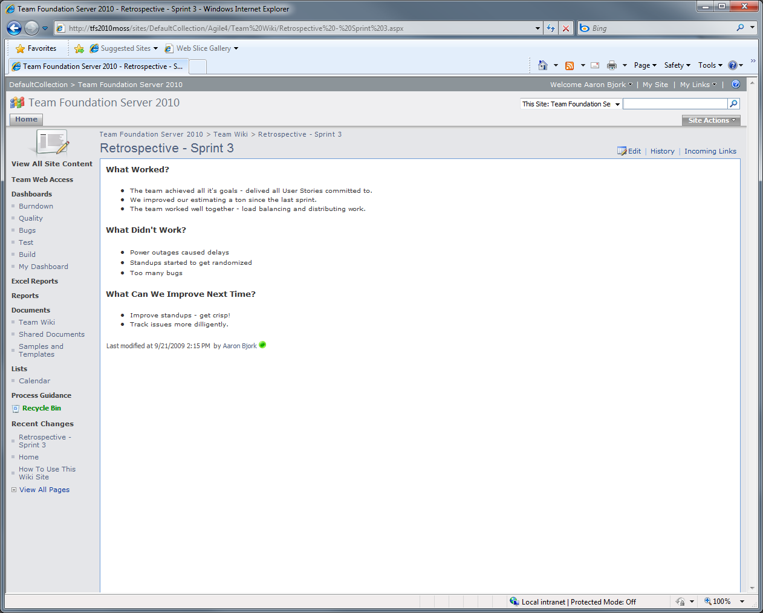
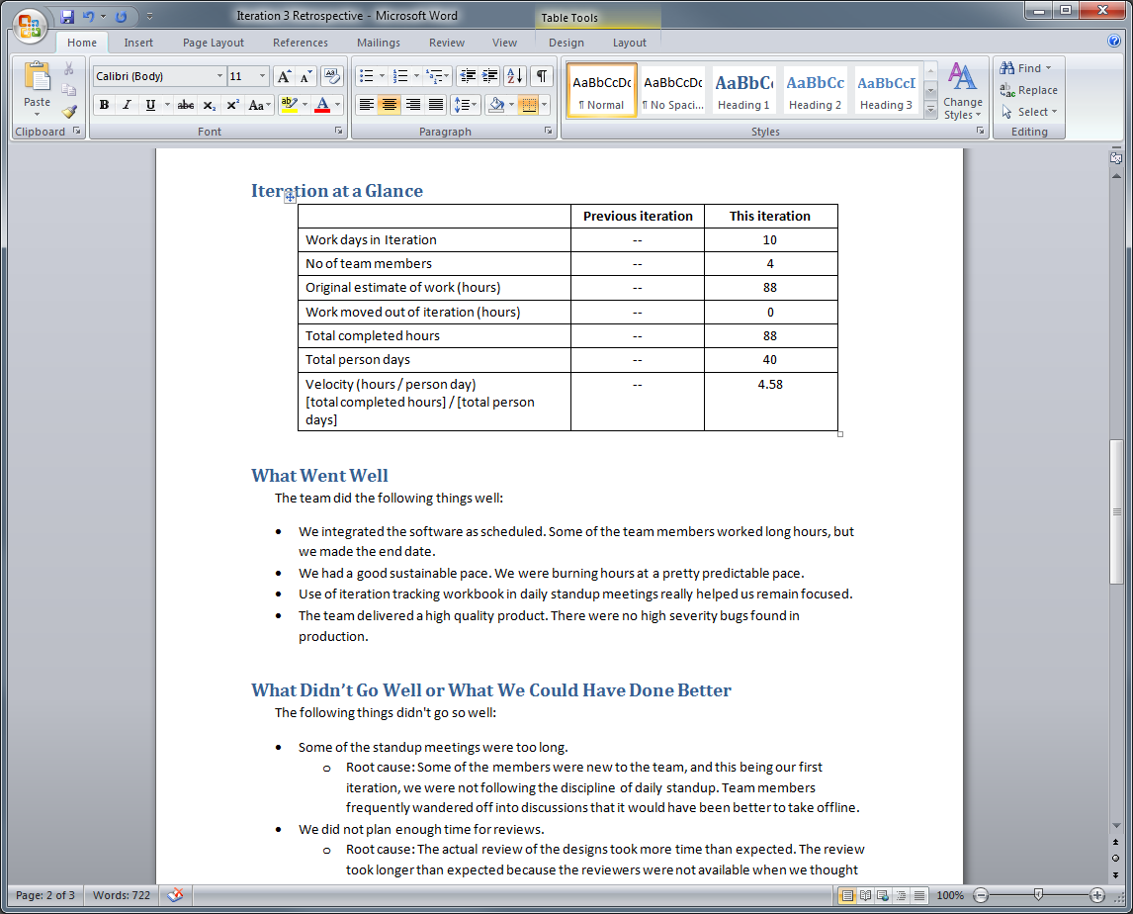
Retrospective
Capture retrospectives using the Team wiki on the Project Portal
Sample documents are provided as a guide

Slide 40
Agenda
Scrum with TFS 2010 using MSF for Agile 5.0
Planning the Project
How do you plan the project?
Project planning in TFS 2010
Planning a Sprint
What is sprint planning?
Sprint planning in TFS 2010
Running a Sprint
How do you run a sprint?
Running a sprint in TFS 2010

Slide 41
Testing and Application Quality

Slide 42




Climbing
Cost of Failure
Conditioning
Training
Training Phase

Slide 43


Slide 44




Release
Cost of Bugs
Test
Development
Software Phase

Slide 45
Push Quality Upstream
Release
Cost of Bugs
Test
Development
Software Phase

Slide 46

Tester Segmentation
Generalist |  |  | Specialist
Manual Testing | Some scripting Creates scripts to set up lab, create data | Strong scripting skills Some coding skills |  | Strong coding Develops fully automated testing procedures | Expert coding skills
70% of testing happens here
majority of test tools target here
Black Box Testing
White Box Testing
API Testing

Slide 47

What usually happens when a tester
finds a bug?
Graphic by Jeff Atwood (CodingHorror.com)

Slide 48
Test Architecture and Developer/Tester Workflow

Slide 49
Visual Studio 2010 Pillars of Application Lifecycle Management
Business Alignment
Effectively plan and deliver the right software that meets your business’ need with clear visibility along the way
Testing & Application Quality
Build applications that really work - starting with great tools to drive quality early planning and development and extending through the test team with powerful new testing tools like functional testing and test case management
Unspoken 3rd “pillar”
Deliver what customers ask for

Slide 50
The Future
Ship 2010!
Power Tools
Project Server
Dev 11 Planning
Requirements
Test & Lab version 2
Collaboration
Deployment & release management

Slide 51
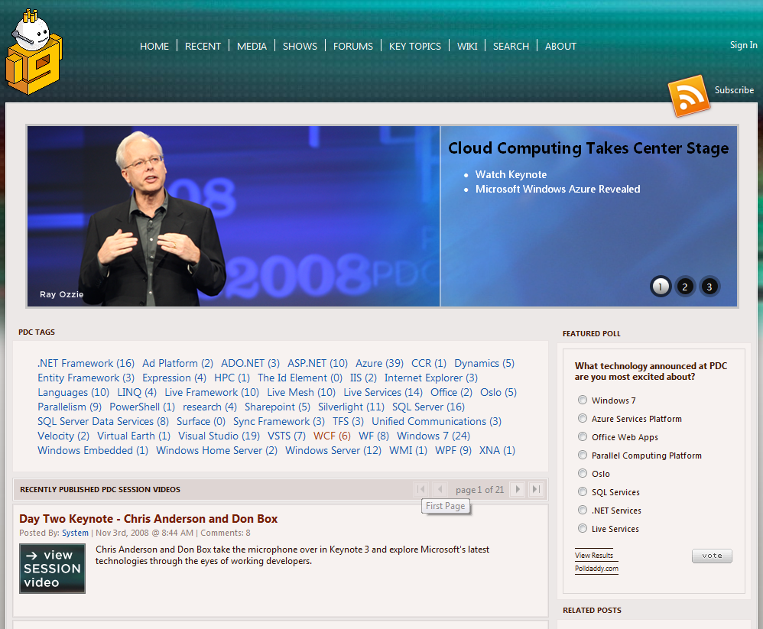
PDC 2008 Session Recordings:
http://Channel9.MSDN.com/PDC2008

Slide 52


10-4 Screencasts
http://Channel9.MSDN.com/shows/10-4/

Slide 53
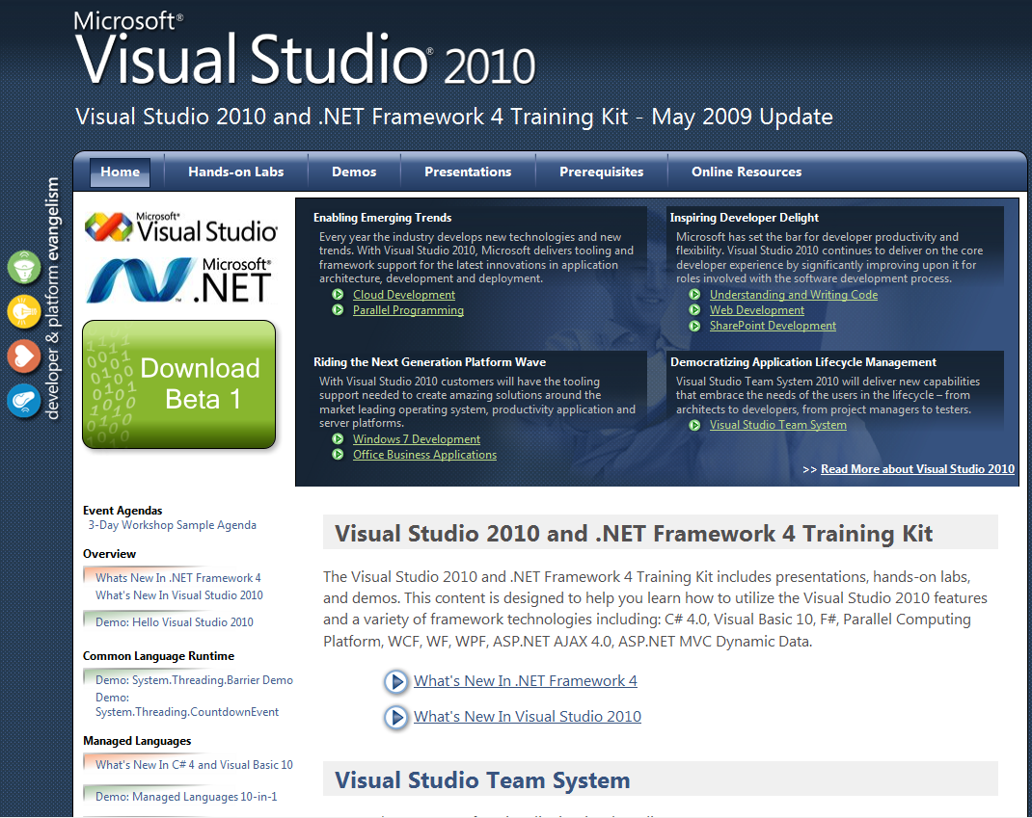
Visual Studio 2010 Training Kit
http://tinyurl.com/vs2010trainingkit

Slide 54

© 2009 Microsoft Corporation. All rights reserved. Microsoft, MSDN, the MSDN logo, and [list other trademarks referenced] are trademarks of the Microsoft group of companies.
The information herein is for informational purposes only and represents the current view of Microsoft Corporation as of the date of this presentation. Because Microsoft must respond to changing market conditions, it should not be interpreted to be a commitment on the part of Microsoft, and Microsoft cannot guarantee the accuracy of any information provided after the date of this presentation. MICROSOFT MAKES NO WARRANTIES, EXPRESS, IMPLIED, OR STATUTORY, AS TO THE INFORMATION IN THIS PRESENTATION.

